Slide 1

ENHANCINGR EHR SECURITY WITH IMMUTABLE LEDGER DATABASES
Mahitha Kalaga CPS 592 – Research Topics in Database

Slide 2
Research Overview
What is the topic? Can immutable Ledger Databases, Like Amazon QLDB replace traditional RDBMS as the architectural standard for EHR security?
Why this topic? In 2004, the change healthcare ransomware attack compromised 192.7 million records and cost $2.4 billion, the largest healthcare breach in U.S. history.
Resources used IEEE Xplore, JAMA Network Open, HHS OCR (hhs.gov), ACM Digital Library, AWS Architecture Blog, PubMed/PMC, IBM Security Reports Presentation Roadmap Threat landscape → Why RDBMS fails → Immutable ledger architecture → Real-world cases → Trade-offs → Comparative analysis → Conclusions

Slide 3
The Ransomware Threat in Healthcare Why healthcare is the #1 target
81% of 2024 breaches were hacking/IT incidents (up from 4% in 2010) 374 ransomware attacks on healthcare orgs 2016-2021 42M patient records exposed

Slide 4
Background: Why Traditional Databases Fail
How a Database Ransomware Attack Works
The RDBMS Architectural Flaw
Attacker gains access via phishing or stolen credentials.
Escalates privileges to admin/root-level database access.
Ransomware iterates through DB files and encrypts them in-place.
Delete/Update wipes or locks every patient record.
Hospital must pay ransom or restore from potentially weeks-old backup.
MUTABLE STORAGE When a record is updated, the old version is permanently overwritten and gone.
CRUD OPERATIONS CREATE, READ, UPDATE, DELETE are all available, including to ransomware with stolen admin credentials.
NO HISTORY BY DEFAULT RDMBS keeps only the current state. There is no built-in record of what data looked like before an attack.
AUDIT LOGS ARE SEPARATE Log files are often in the same system, an attacker deletes them to hide their tracks.

Slide 5
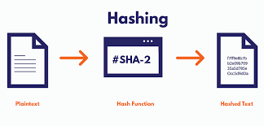
Immutable Ledger Databases Architecture How append-only design defeats ransomware
Amazon QLDB
Append-only (no delete or overwrite)
Full history of all records.
Cryptographically linked data.
Built-in ransomware resistance
Managed immutable ledger database.
(AWS)Tracks all data changes.
Verifiable audit history.
Supports historical queries

Slide 6
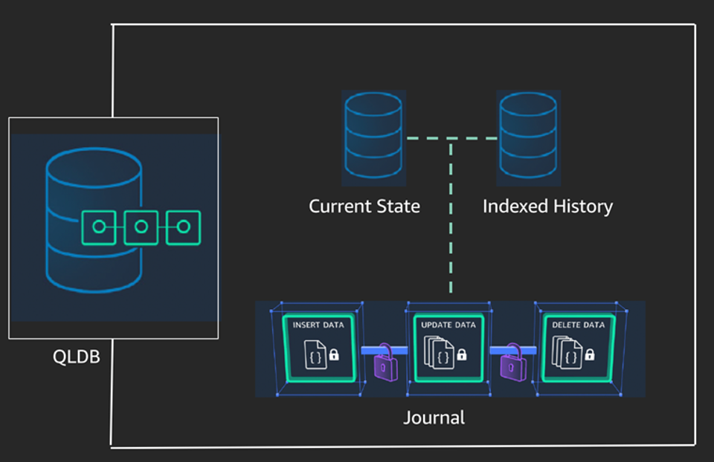
Real-World Cases
Amazon QLDB (AWS)
Team fEMR healthcare system
HIPAA-compliant deployments
Blockchain-based EHR research

Slide 7

Trade-Offs
Higher storage usage
Slower historical queries
Migration complexity
Cloud dependency

Slide 8

Comparative Analysis
 | Feature | RDMBS | Immutable Ledger
1 | Data model | Mutable | Append-only
2 | Ransomware resistance | Weak | Strong
3 | Audit trail | External | Built-in
4 | Recovery | Backup Based | Instant history

Slide 9

Conclusion
RDBMS vulnerability is architectural
Immutable ledgers prevent data destruction
Strong defense against ransomware
Security > flexibility in healthcare

Slide 10
Future Work and Observations
Hybrid DB systems
Performance optimization
Wider adoption
On-prem solutions (immudb)
Problem is architectural
Solutions already exist
Adoption is the bottleneck

Slide 11
Thank You
Mahitha Kalaga

